Slide 1

Object Detection
Region proposals
(Optional)
deeplearning.ai

Slide 2

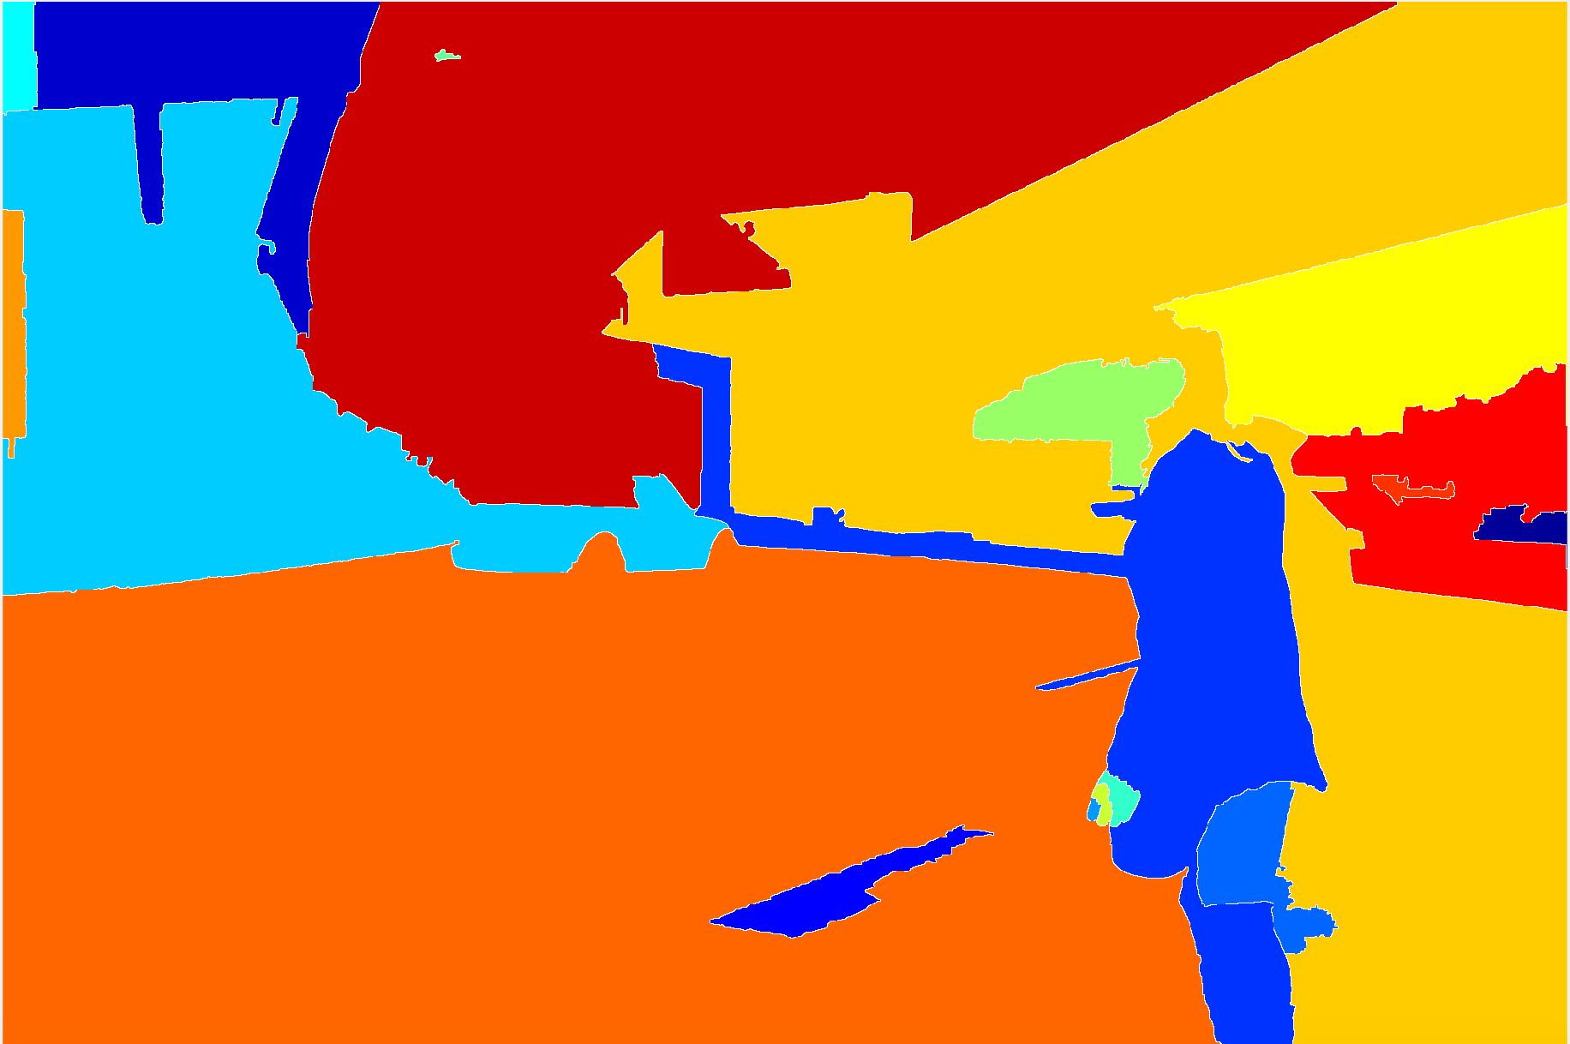
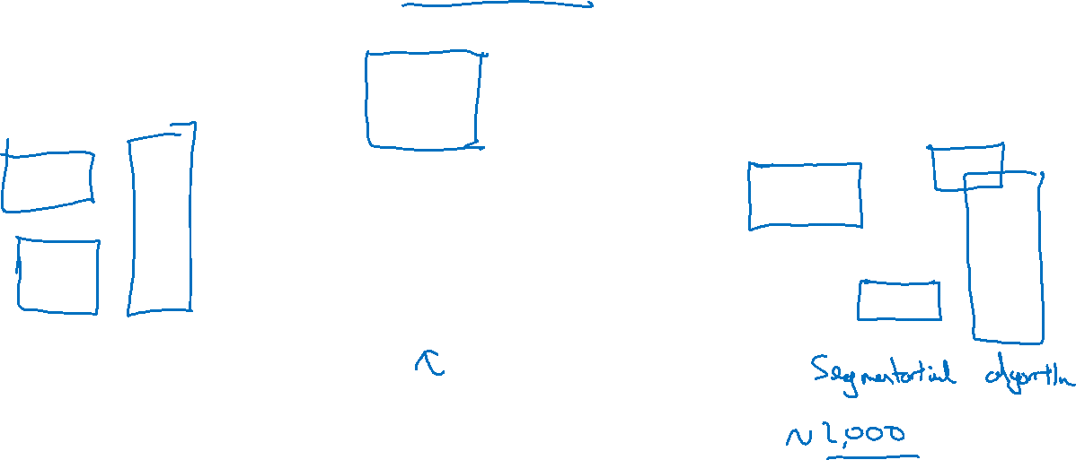
Region proposal: R-CNN
[Girshik et. al, 2013, Rich feature hierarchies for accurate object detection and semantic segmentation]

Slide 3
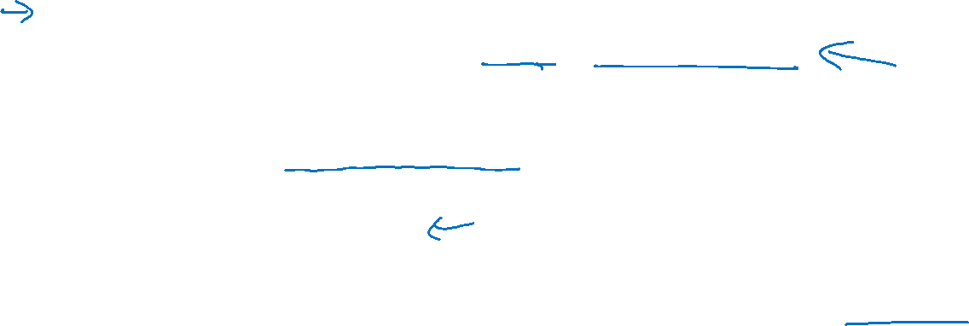
Faster algorithms
R-CNN:
Propose regions. Classify proposed regions one at a time. Output label + bounding box.
Fast R-CNN:
Propose regions. Use convolution implementation of sliding windows to classify all the proposed regions.
Faster R-CNN:
Use convolutional network to propose regions.
[Girshik et. al, 2013. Rich feature hierarchies for accurate object detection and semantic segmentation]
[Girshik, 2015. Fast R-CNN]
[Ren et. al, 2016. Faster R-CNN: Towards real-time object detection with region proposal networks]

